Slide 1
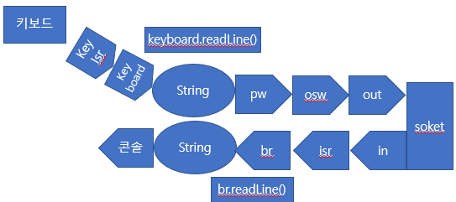
Main Thread
soket
server.accept()
EchoThread.start()
Echo Thread
out
osw
pw
String
in
isr
br
br.readLine()

